Slide 1
Software Design

Slide 2
Software Design
Software Design
More creative than analysis
Problem solving activity
WHAT IS DESIGN
HOW’
Software design document (SDD)

Slide 3
Software Design
Initial requirements
Gather data on user requirements
Analyze requirements data
Obtain answers to Requirement questions
Validate the design against the requirements
Conceive of a high level design
Refine & document the design

Slide 4
Software Design
Design Customer Developers
(Implementers)

Slide 5
Software Design
conceptual design answers :
Where will the data come from ?
What will happen to data in the system?
How will the system look to users?
What choices will be offered to users?
What is the timings of events?
How will the reports & screens look like?

Slide 6
Software Design
Technical design describes :
Hardware configuration
Software needs
Communication interfaces
I/O of the system
Software architecture
Network architecture
Any other thing that translates the requirements in to a solution to the customer’s problem.

Slide 7
Software Design
The design needs to be
Correct & complete
Understandable
At the right level
Maintainable

Slide 8
Software Design
Informal design outline
Informal Design
More Formal Design
Finished Design

Slide 9
Software Design
MODULARITY
A modular system consist of well defined manageable units with well defined interfaces among the units.
Modularity is the single attribute of software that allows a program to be intellectually manageable.
It enhances design clarity, which in turn eases implementation, debugging, testing, documenting, and maintenance of software product.
There are many definitions of the term module. Range is from :
i. Fortran subroutine
ii. Ada package
iii. Procedures & functions of PASCAL & C
iv. C++ / Java classes
v. Java packages
vi. Work assignment for an individual programmer

Slide 10
Software Design
Properties :
i. Well defined subsystem
ii. Well defined purpose
iii. Can be separately compiled and stored in a library.
iv. Module can use other modules
v. Module should be easier to use than to build
vi. Simpler from outside than from the inside.

Slide 11
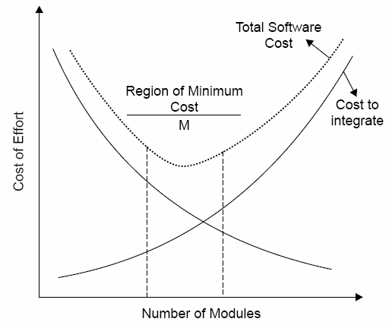
Software Design

Slide 12
Software Design - Coupling
Data coupling
The dependency between module A and B is said to be data coupled if their dependency is based on the fact they communicate by only passing of data. Other than communicating through data, the two modules are independent.
Stamp coupling
Stamp coupling occurs between module A and B when complete data structure is passed from one module to another.
Content coupling
Content coupling occurs when module A changes data of module B or when control is passed from one module to the middle of another.

Slide 13
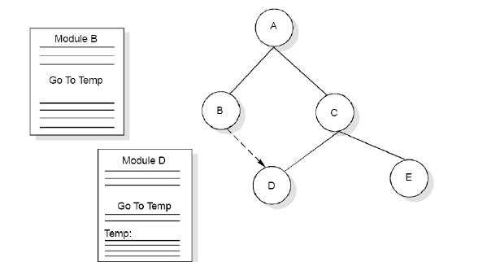
Example of Content Coupling

Slide 14
Coupling
Control coupling
Module A and B are said to be control coupled if they communicate by passing of control information. This is usually accomplished by means of flags that are set by one module and reacted upon by the dependent module.
Common coupling
With common coupling, module A and module B have shared data. Global data areas are commonly found in programming languages. Making a change to the common data means tracing back to all the modules which access that data to evaluate the effect of changes.

Slide 15
Software Design
Module Coupling
Coupling is the measure of the degree of interdependence between modules.

Slide 16
Software Design
Loosely coupled:
some dependencies
(B)
Highly coupled:
many dependencies
(C)

Slide 17
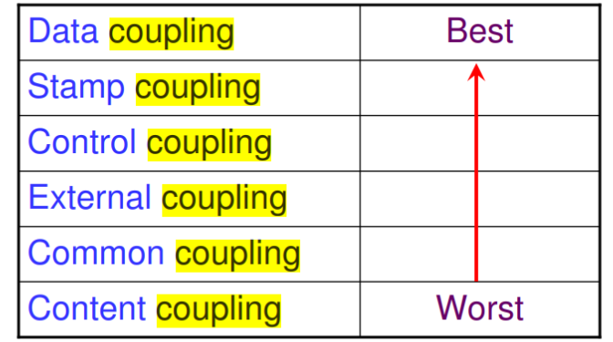
Software Design- Coupling
This can be achieved as:
Controlling the number of parameters passed amongst modules.
Avoid passing undesired data to calling module.
Maintain parent / child relationship between calling & called modules.
Pass data, not the control information.

Slide 18
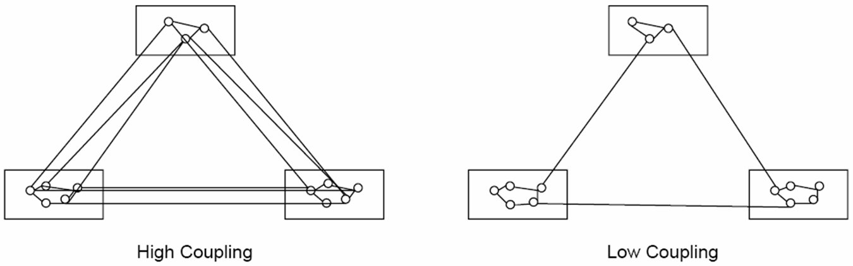
Coupling

Slide 19
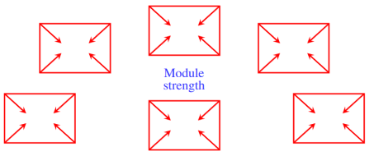
Cohesion
Cohesion is a measure of the degree to which the elements of a module are functionally related.

Slide 20
Cohesion
Types of cohesion
Functional cohesion
Sequential cohesion
Procedural cohesion
Temporal cohesion
Logical cohesion
Coincident cohesion

Slide 21
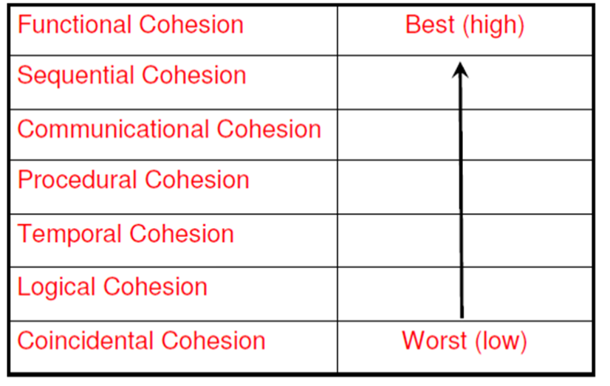
Types of module Cohesion

Slide 22
Types of Cohesion
Functional Cohesion
A and B are part of a single functional task. This is very good reason for them to be contained in the same procedure.
Sequential Cohesion
Module A outputs some data which forms the input to B. This is the reason for them to be contained in the same procedure.

Slide 23
Types of Cohesion
Procedural Cohesion
Procedural Cohesion occurs in modules whose instructions although accomplish different tasks yet have been combined because there is a specific order in which the tasks are to be completed.
Temporal Cohesion
Module exhibits temporal cohesion when it contains tasks that are related by the fact that all tasks must be executed in the

Slide 24
Types of Cohesion
Logical Cohesion
Logical cohesion occurs in modules that contain instructions that appear to be related because they fall into the same logical class of functions.
Coincidental Cohesion
Coincidental cohesion exists in modules that containinstructions that have little or no relationship to one another.

Slide 25
Multiple-Choice Questions
1. T or F? Coupling and cohesion are closely linked in that as one increases, so does the other.
a. True
b. False
2. Given classes A and B, which of the following is not a common type of coupling in object-oriented software?
a. A is a direct or an indirect subclass of B
b. A method parameter or local variable in A references B
c. A has an instance variable that refers to B
d. A invokes methods of B
e. None of the above

Slide 26
Multiple-Choice Questions
3. What is the typical relationship between coupling and cohesion?
There is no relationship between coupling and cohesion.
b. As cohesion increases, coupling increases.
c. As cohesion increases, coupling decreases.
4. All else being equal, which is more desirable?
Higher cohesion and higher coupling
Higher cohesion and lower coupling
Lower cohesion and lower coupling
Lower cohesion and higher coupling
None of the above is more desirable than the others.
Solutions: 1. b (as coupling increases, cohesion decreases) 2. e 3. c 4. b

